Slide 1

Move Fast & Don't Break Things
Ankit Mehta, Google

Slide 2

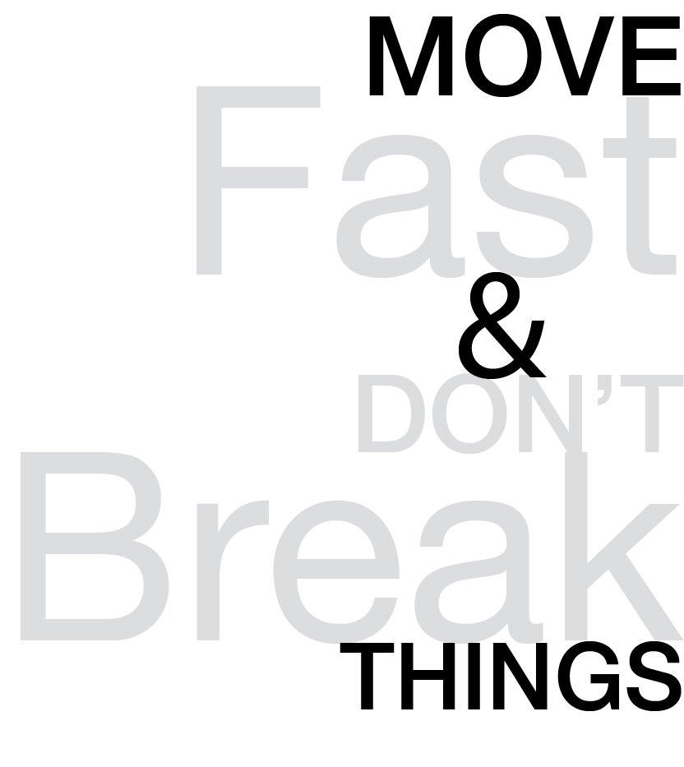
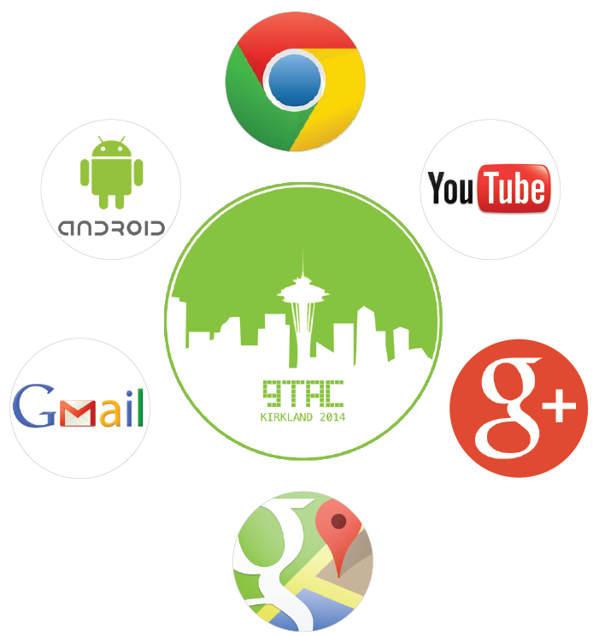
Move Fast & Don’t Break Things
Ankit Mehta, Google
GTAC 2014
Notes:
Welcome to GTAC 2014. This time we wanted to make this a bright and sunny GTAC. so Seattle was the obvious choice
Last year it was in NY and hugely successful. It was thematic and this year we elected to keep it open as some felt constrained by a theme. Last year there were 500 submissions for talks and this year over 1500 so this continues to be something the community is highly engaged with.
1524 applicants (238 Googler, 1286 external) - about 3x as many as last year
250 attendees selected (including speakers)
Over the next 2 days; prepare to be amazed by how much people can talk and even more amazed by how much you can listen to.
What excites me about GTAC: Booze. though well at Google; we get lots of it
On a more serious note; I continue to be amazed every year with all the stuff folks are doing in the industry and the huge variance if how we approach testing. Google especially has a different take on Testing and it immensely helps us share with all of you what we do and learn from you all wrt how you guys approach testing.

Slide 3
Move Fast & Don’t Break Things
Why am I talking @ GTAC
Sharing my experience of a decade @ Google in Test Engineering
Passionate about balance between velocity and quality
Taking an opportunity to share Google’s take at balancing velocity and quality
Interesting side projects @ Google:
MAD (Millions of Automated Documents)
Scale Google’s Bug database
Surveytool
Microprocessor controlled pick n place manipulator (school)
Notes:
MAD (Millions of Automated Documents): had to create millions of docs to stress test Google Search Appliance and Desktop. automated word excel AIM etc.
Scale Google’s bug DB: Whoever was maintaining it; one fine day left it under my desk as my team/product accounted for 1/5th of the bugs @ Google. and then I sped it up to 10x (12x to be exact) via drum roll.. moving it to a datacenter from under my desk :)
Thankfully; Google replaced that with a better state of the art bug database. so googlers weren’t left to deal with bugs I encountered while backing up db, updating packages in the bugs DB. Yes. we must do deeper..
Surveytool. My learning wrt how not to scale products. 20% project. App engine, Google Forms and Google+ Polls didn’t exist back then. Much to my initial joy and later dismay; it took on too much traction; that one year Google HR deduced to use it for Google’s annual survey. Within mins of the email going out; it melted.
I spent the next 2 days recovering all data happily retired the tool a month after that :)
Before Google worked on a Robot with a buddy; Learned that software is much easier than hardware to mold.

Slide 4
Move Fast & Don’t Break Things
Test Engineering
“what is our purpose?”
Build world class infrastructure to launch high quality innovative products fast that delight our users
Notes:
This is what we believe Test Engineering @ Google is about.
Dual focus. building infrastructure and tooling that helps us test things at a scale no one else has before; and
Testing and automating things right from autonomous cars to glass to how blue is this blue wrt our Photo editing software.

Slide 5

Move Fast & Don’t Break Things
Google from the outside..
Notes:
Of course it’s Google; the land of Chrome, Gmail, Youtube.. free food.. shuttles.. best place to work.. Google makes so many cool products. I am sure. it’s fun to code within Google and it is depending on your definition of fun and what codebase you are working with.

Slide 6
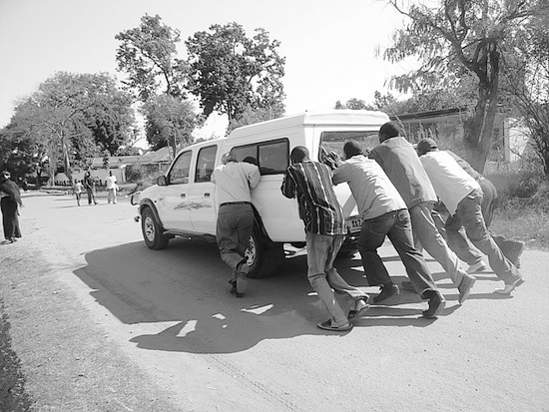
Google from the inside…
Move Fast & Don’t Break Things
Notes:
Complex products, integrations, legacy code bases..
remember when I had to add a feature in Gmail 5 years back: google feedback in Gmail; It took me almost 2 month to do so.
had to create a separate module (every feature in Gmail is a module); had to refactor another another module, deal with race conditions; had to lazily load the js; had to keep the additional javascript to a bare minimum. write unit tests; write the automated UI test.
I had a set of rules I had set for all feature additions to Gmail and I revised them after this experience :)

Slide 7
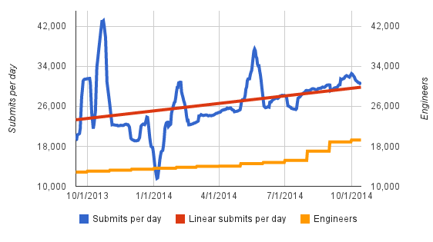
Move Fast & Don’t Break Things
More code
30K check-ins per day
A check-in every 3s!
Notes:
I have been tracking this data for the last few years. and my assumption was that this would slow down as we kept hiring more folks.
It hasn’t.
As you can see in the graphs; things get really exciting in Nov; before the holidays. have no idea why we still have 10K+ cls checked in over Dec. who are all these ppl!
and then you see the bumps post holidays and before IO.
Lastly; if anything I now expect these numbers to grow even more with Google (as the rest of the industry) getting more actively in Mobile App development.

Slide 8
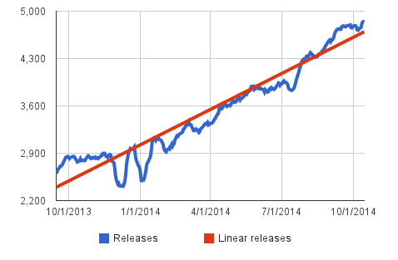
Move Fast & Don’t Break Things
More releases
2x more releases
Notes:
Newer teams; newer projects like Fiber, Google x projects, increased efficiency wrt presubmits and postsubmits, higher velocity have led to teams building more products and shipping them more frequently.
One of the other reasons we are doing more releases is we are aggressively going Mobile first ; we are buiding our apps in more platforms: Android iOS, Mobile Basic.
It is also a testament to the Release Engineers @ Google with how well they have automated the release process/tooling that a lot of teams can self sustain themselves wrt their release needs. and of course Our SREs are the best. They ensure Google is always up and most of our products infrastructures have very high availability. Google publishes these numbers.

Slide 9
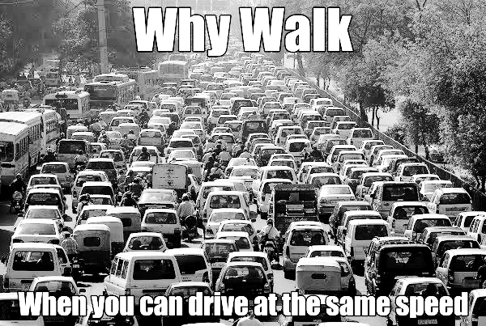
Move Fast & Don’t Break Things
State of releases
Releases have long cycles; hence everyone wants in
Lack of discipline/time pressure leads to regressions and further delays
No way to isolate issue and hence further delay and work around it
Notes:
Few years back on Gmail; we realized while we had weekly releases; we were getting releases out to prod every 3 weeks.
We set a goal to iterate faster and we decided to embark on the journey of daily releases.
One e.g. motivator was a latency issue in IE related to adding a pseudo hover rule which triggers a reevaluation of style rules every time the cursor is moved from one element to another and in case of IE it was trigger all rules. We had a sophisticated latency regression system which was capable of detecting 25 ms regressions; but that didn’t notice this as we didn’t have hover related automation. We had to use prod for narrowing down cl delta and the iterations; given the 3 week cltoprod took us almost a quarter to find the culprit cl.

Slide 10

Move Fast & Don’t Break Things
Moving Fast is Good!
Innovate
Address flaws quickly
Better productivity
Better Code Health
Notes:
Innovate: to build products quickly and iterate on the feedback and make them better. We all know what happens to companies that don’t innovate and do it quickly; especially in the tech industry. Innovation is now not only the sexy thing to do; it is necessary for survival . It is also a great tool to attract the best talent in the industry and retain it. Go back a decade and remember yourself in a similar conference. you were sitting in your chair without a smartphone in your end and at best checking your emails over and over again. now you can play Candy crush while you are listening. not that I am recommending you do that over GTAC :)
Address flaws quickly: Address critical bugs quickly and painlessly. This is a chicken and egg kinda thing. you can’t move fast without this ability and you can’t do this without moving fast. at some point; you just have to take a leap of faith; believe in yourself and your team and take the plunge. This is highly addictive; once you know you can react this quickly; you have the discipline to ensure not too many things are slipped under the rug and shipped to prod.
Better productivity: Automation is a key ingredient to this and that in turn helps rapid development. if you write code that doesn’t compile your IDE will complain as it continuously runs tests in the background. if you write code that breaks an existing test; it will complain; if you write code without a test; the presubmit will complain and so will the human reviewer. We now have tools @ Google which show incremental code coverage numbers for every cl.
Better Code Health: Folks don’t try to slide things in to catch a release as there is one going every day! if you got a key integration wrong; you find out about it immediately in local development or worse case in fishfood(more abt that later). and this in the long term really helps a product survive longer. Typically IMO every software has a 15 year cycle: 0-2 year build time(depending on the complexity); a 7 year shelf live. and then it’s in maintenance mode for 3 more years and then in derpreciation/migration mode for the next 3. Focusing on Code Health from the start will help made this ride smoother; especially the later part of the ride :)

Slide 11

Move Fast & Don’t Break Things
… But Breaking things isn’t
User trust/satisfaction
Uphold the brand
Launch products
Set a high bar
Notes:
User trust: We owe it to our users to ship high quality products. Every company and business do. Missing key features led to a unhappy user experience with the product. The product feels clunky or bloated and it isn’t successful eventually
Launch: Some of the bigger tech companies are finding their launches slip by years. The bug find rate matches or surpasses the bug fix rate. I believe that for every 5 regressions/bugs fixed; 1 gets introduced. just a back of envelope number based on doing this for a decade. Hence it’s important to not have too many bugs to fix to start with. I am not saying let’s stop finding/catching bugs; what I am saying is: Prevent them to start with. (more about that later)

Slide 12
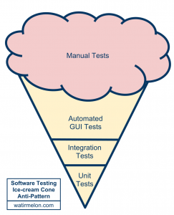
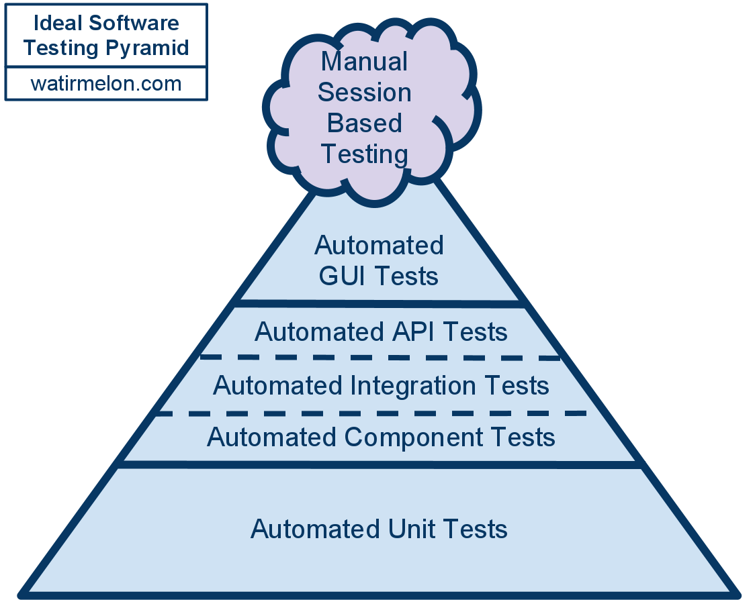
My Testing Philosophy
Move Fast & Don’t Break Things
What many teams do
How it should be done
Maintenance
Slower tests
Flakiness
Notes:
Alister is here in the crowd.
Very often; when folks talk about automation; they think about UI automation. Very often; that’s a hard thing to do as it has lots of moving pieces and lots of infrastructures in the test stack.
I know a team is doing too much UI automation when they are finding NPEs via their UI automated tests.
Manual Session based testing is a fancy way of saying exploratory testing. I strongly believe that if testers are executing a set of test cases over and over again; we should automate them; unless in rare circumstances; the ROI to automate them isn’t there.
Exploratory testing is extremely valuable and I keep wishing my teams do more of this. As your automation can only hit so many code paths and it keeps hitting them over and over; whereas; exploratory testing helps expose bugs in code paths which could have never been hit before. For e.g. in Google+ Photos; there are various ways to upload Photos. from a post; from the Photos landing page; from within an album landing page, upload them to a drive folder etc. we could write tests for all these scenarios; but we will never cover all the different permutations and what a user might possibly do. That is an area where having automation is great; but we need to back it up with exploratory testing
Automated API tests are the best bang for the buck wrt tests that are easy to write and stable and a reliable signal.
Integration Tests are always valuable; but we need to ration the number of integration tests one writes as they can be more difficult to debug and have a high noise factor due to all the moving pieces
Automated component testing allows one to test a particular component (server) in isolation. you mock everything else out and ensure this component behaves as intended
As evident; the cone needs to be inverted in a lot of teams and companies. There is too much focus on Automated UI testing. At Google; we realized that half a decade back and have been putting in the required effort in the Integration testing and unit testing layer.

Slide 13
Move Fast & Don’t Break Things
Move Fast & Don’t Break Things
Notes:
I took a step back and summarize the key things we did to get from “driving at the same speed as walking” to “driving at the same speed as flying”

Slide 14
Move Fast & Don’t Break Things
Push on Amber
Move Fast & Don’t Break Things
Notes:
Push on Amber: Yes. Amber and not Green.

Slide 15
Move Fast & Don’t Break Things
Push on Green..
“As soon as test suites go green, deployment to production is automatically started”
This has evolved at Google. We have tens of thousands of tests for some projects, some of which could be failing and/or flaky
Notes:
First a detour to “Push on Green”
Kent Beck in 2003 came up with the idea.
This is a great step in the right direction. if you are not doing this already; please do so.
@ Google we started reaching the limits of Push on Green and it enabling or limiting us in what we wanted to do.
In an ideal world; we should push on green; but we live in a practical world.
I want baby carriers with beer holders; but they don’t make them. so I improvise and use my denim back pocket as my beer holder.
Coming back to Google:
Some teams have non-hermetic tests or tests that are hermetic; but at some point depend on some staging/dev server.
A test (manual or automated) might be failing due to a backend bug; should the frontend be blocked on that bug?
The point I am trying to make is; folks need to assess and make educated judgement calls. and we do that and that’s what I refer to as “Push on Amber”

Slide 16
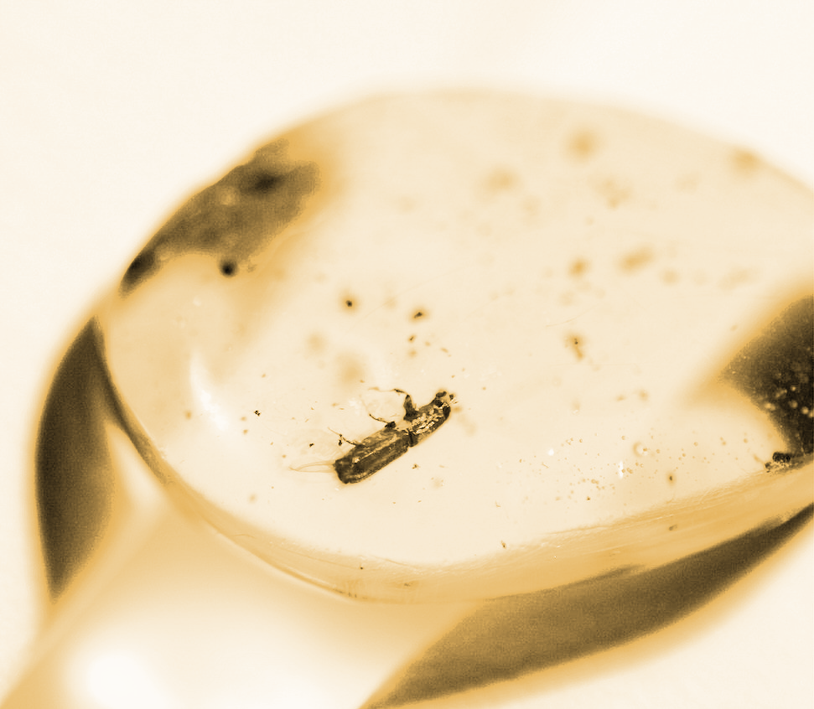
Move Fast & Don’t Break Things
Push on Amber
Daily pushes to prod
Stable top of tree
Smarter regression testing
Critical tests cannot be bypassed
Notes:
Push on Green was the past..
The expectation we set and try to meet almost every day is that you check in your code at 4PM today; it will be launched by 4PM tomorrow.
We have hourly release cuts and at 6PM we graduate the latest cut to a release headed to prod.
We have a team of testers ready in a different timezone; we have spent years getting them calibrated on the product and they regression test and log regressions. We have folks ready to cull through change list delta and they they revert buggy code and make new patches and by the the time we come in to work next day; the release is ready to go to prod. We do some final verification in early AM; push to canary; look at numbers and then push to prod. At every step all automated tests are re-run to ensure nothing has regressed further or no new regressions have been introduced.
Some things we do wrt smarter regression testing:
Just regression test affected part of the code base for patches
We instrumented servers to help us evaluate code coverage of manual testing.
Have 7 parallel test stacks to help narrow down regressions

Slide 17
Move Fast & Don’t Break Things
Push on Amber
Prevent Bugs
Move Fast & Don’t Break Things
Notes:
Prevent bugs: Ideally code checked in produces perfect products

Slide 18
Move Fast & Don’t Break Things
Prevent Bugs
Prevent bugs and not catch them
Deterministic hermetic tests
Prevent bad code from getting in
High presubmit coverage and usage
Notes:
While catching bugs is great; my mantra is: “Prevent bugs and not catch them”. That helped the team think beyond just manual and automated testing and also about hermetic automation. more about that later.
To stay ahead of the curve; you need less bugs in the product to start with and one way to achieve that is via preventing crappy code from been checked in.
On the products I have worked on; we made our automation framework a feature of the product; it compiled along with the product; code for that feature didn’t ship to prod and hence users didn’t have to download it.
It also allowed us to just test the SUT and fake everything else out.
Over the last couple of years; we have taken it to the next level and we don’t even have the fake servers. we push back recorded responses to the SUT and verify it’s behavior and the responses are auto updated as changes are made to the server. This has helped us speed up our tests further.
For e.g.
200 total bugs/5 bugs fixed per day = 40 days
10 total bugs/2 bugs fixed per day = 5 days
Which one of these 2 scenarios is better. the choice is clear.

Slide 19
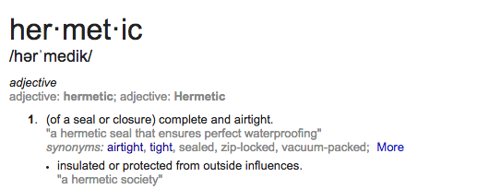
Move Fast & Don’t Break Things
What is a Hermetic Test?
The short definition would be a “test in a box”.
My version: run a test while on a airplane *without network
Notes:
This is another concept on which I have made my living @ Google.
What do I mean by hermetic: Google says complete and airtight.
I was frustrated seeing tests randomly switch from green to red and back to green. It didn’t help an ounce wrt motivation for the test team and/or to get SWEs excited about the automation we had and/or to write more automation. For a good year or so on Gmail; we didn’t write any new automation; till we came up with a way to write hermetic tests.
If you can start up the entire test on a single machine that has no network connection AND the test works as expected, you have a hermetic test! This is a special case of the more general “hermetic” concept which applies to an isolated system not necessarily on a single machine.

Slide 20
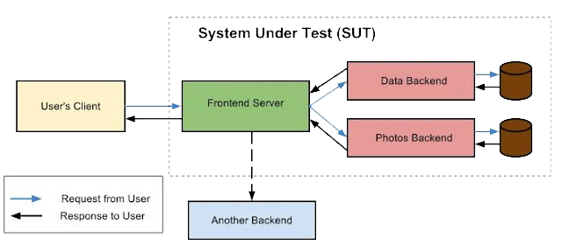
Non-Hermetic Servers
Move Fast & Don’t Break Things
Before
Notes:
Consider a complex and rich web app. Under the hood, it is probably a maze of servers, each performing a different task and most talking to each other. Any user action navigates this server maze on its round-trip from the user to the datastores and back. A lot of Google’s web apps are like this. So how do we write end-to-end tests for them?
An end-to-end test in the Google testing world is a test that exercises the entire server stack from a user request to response. Here is a simplified view of the System Under Test (SUT) that an end-to-end test would assert. Note that the frontend server in the SUT connects to a third backend which this particular user request does not need.
One of the challenges to writing a fast and reliable end-to-end test for such a system is avoiding network access. Tests involving network access are slower than their counterparts that only access local resources, and accessing external servers might lead to flakiness due to lack of determinism or unavailability of the external servers.

Slide 21
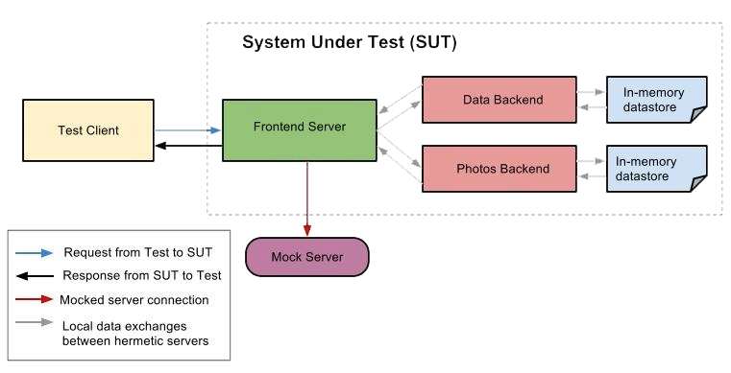
Hermetic Servers
Move Fast & Don’t Break Things
After
Notes:
One of the tricks we use at Google to design end-to-end tests is Hermetic Servers.
What is a Hermetic Server? The short definition would be a “server in a box”. If you can start up the entire server on a single machine that has no network connection AND the server works as expected, you have a hermetic server! This is a special case of the more general “hermetic” concept which applies to an isolated system not necessarily on a single machine.
Why is it useful to have a hermetic server? Because if your entire SUT is composed of hermetic servers, it could all be started on a single machine for testing; no network connection necessary! The single machine could be a physical or virtual machine.
The end-to-end test does the following steps:
starts the entire SUT as shown in the diagram on a single machine
makes requests to the server via the test client
validates responses from the server
This end-to-end test is more reliable because it uses no network connection. It is faster because everything it needs is available in-memory or in the local hard disk. We run such tests on our continuous builds, so they run at each changelist affecting any of the servers in the SUT. If the test fails, the logging module helps track where the failure occurred in the SUT.

Slide 22
Move Fast & Don’t Break Things
Push on Amber
Prevent Bugs
Move Fast & Don’t Break Things
Push Testing upstream
Notes:
Push Testing upstream: Don’t try to do it all yourself. Spread the love of testing

Slide 23
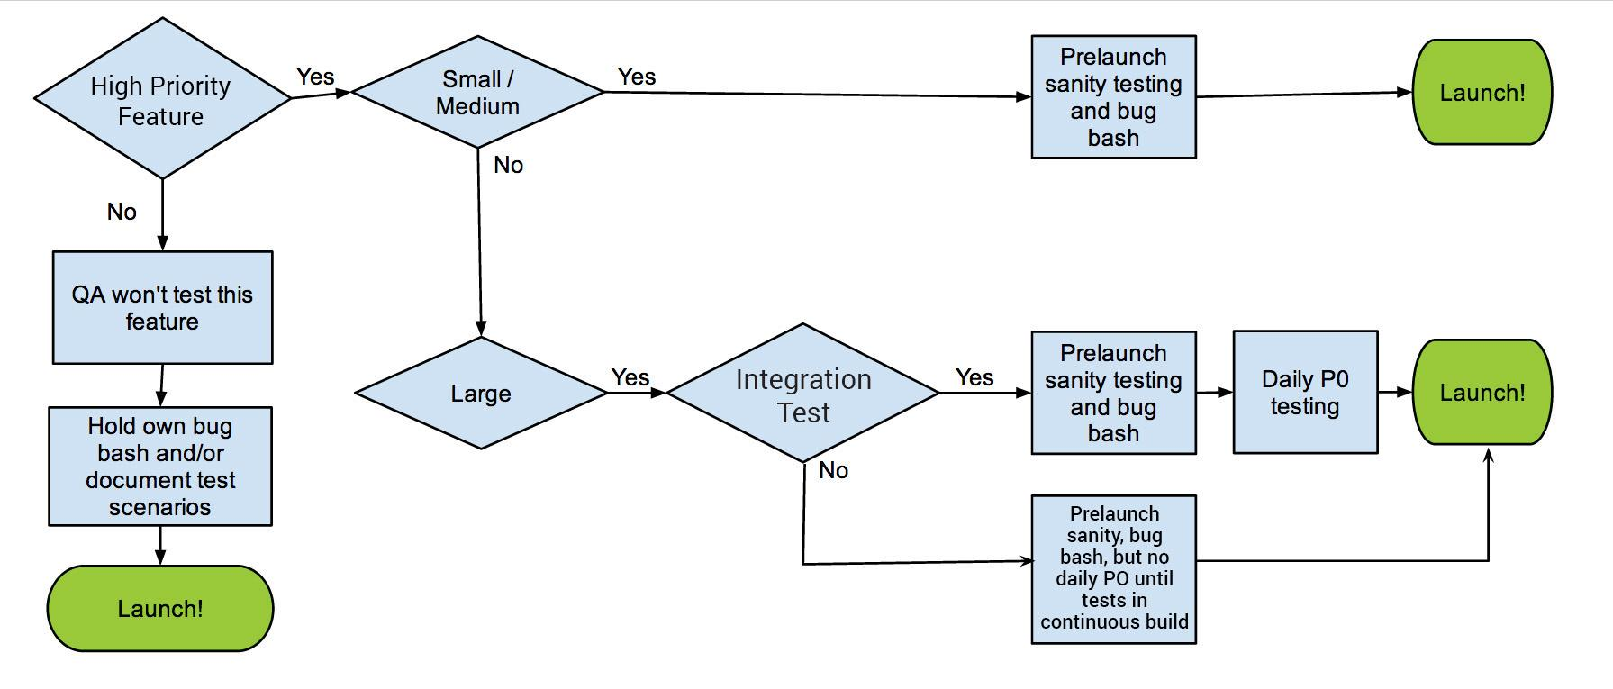
Pushing Testing Upstream
Move Fast & Don’t Break Things
Notes:
This was probably the single most important prioritization work I did for my team @ Google. and as with all good things; this was by accident :)
I drew this up mostly to help me understand how we would scale our testing needs; but it immediately helped the team and other disciplines understand our SLA
we require integration tests for only large features. ideally we should have tests for all features; but with lots of features launching all the time; we throttle the number of tests.
Highly encourage you all to do something similar if you are dealing with trying to test too much…
One of the mismatches I realized was the feature owner and the automation owner were 2 different folks. that led to the tests getting out of sync with the product and some teams were in forever test maintenance mode. When I asked the SWEs why they were not writing tests; they said the framework was too complicated; they didn’t want to learn and/or write their tests in java; when they were building complex AJAX apps in js. for the FE. so we built a framework which made writing UI tests as simple as unit tests and rest is history. We reduced the barrier for writing tests. Let me repeat that: “We reduced the barrier for writing tests”
On the Test engineer aspect; Google+ for example launches 100 features in it’s first 100 days. It was impossible to test all the features. so we helped the SWEs and PMs involved in testing. We mentored them to write test plans and organize their own bug bashes and we would triage the bugs together. We made bug bashes self service. Again repeating myself: we made the bug bashes self service.

Slide 24
Move Fast & Don’t Break Things
Push on Amber
Prevent Bugs
Move Fast & Don’t Break Things
Push Testing upstream
Delineate product releases and features
Notes:
TODO

Slide 25
Move Fast & Don’t Break Things
Delineate product releases and features
Releases always keep rolling
Dark launch features
Revert features and not revert releases
Launch releases without leaking features
Notes:
This disengages the release train from feature specs/changes. It helps us ensure one feature doesn’t block another and/or none of the features restrain our ability to reach to critical flaws quickly. What do I mean by a feature. When we launch Inbox by Gmail; that’s a new product. When we launch stuff like Polls in Google+; that’s a feature.
It also helps us test new features/backends silently wrt how they react in the existing stack.
Most importantly; if we launch a feature which has a critical flaw; It helps us immediately turn it off without having to do an expensive binary rollout or rollback

Slide 26
Move Fast & Don’t Break Things
Push on Amber
Prevent Bugs
Move Fast & Don’t Break Things
Push Testing upstream
Delineate product releases and features
Productivity First
Notes:
Productivity First: Care about yourself and your product team too. Users come first; but to me my product team is my second family

Slide 27
Move Fast & Don’t Break Things
Productivity First..
Invisible Tests
Tests an asset and not a liability
Fast UI Automation
Zero tolerance on flakiness
Notes:
When tests pass; no one notices them…
under 5 min UI automation tests
How tests have become a nightmare. due to flakiness. stability.
I remember when I joined a team about 7 years back; I was excited; to be in server world @ Google. had been on client stuff before. When I asked around folks told me they had 1000s of end2end automated tests. I was like w00t! Turns out only 100s of them were providing real enough signal. some were flaky; some were broken forever.

Slide 28
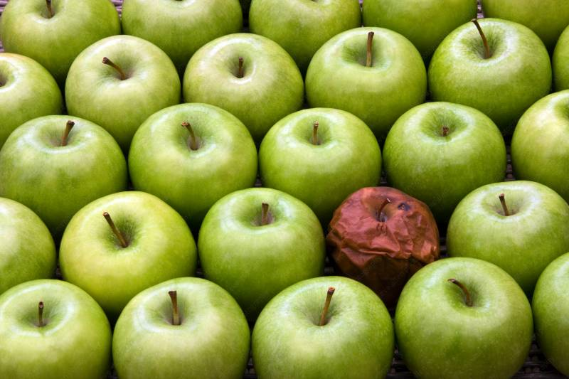
Attack Bad Tests
Move Fast & Don’t Break Things
Slow Tests
Flaky Tests
Notes:
Identify the bad tests. There are 2 kinds of bad tests.. Slow and flaky. even 1 flaky test out of 5000 tests would cause submits to fail and slow everything down. and if tests take too long to run; a) folks will be more likely to skip them and b) that doesn’t exactly help motivate folks to write more tests.
For e.g on Google+ we had Communities UI test that we had before which took 11 mins is now: Communities component test ( test process time ~ 1 min) and Stream component test (~1 min as well).

Slide 29
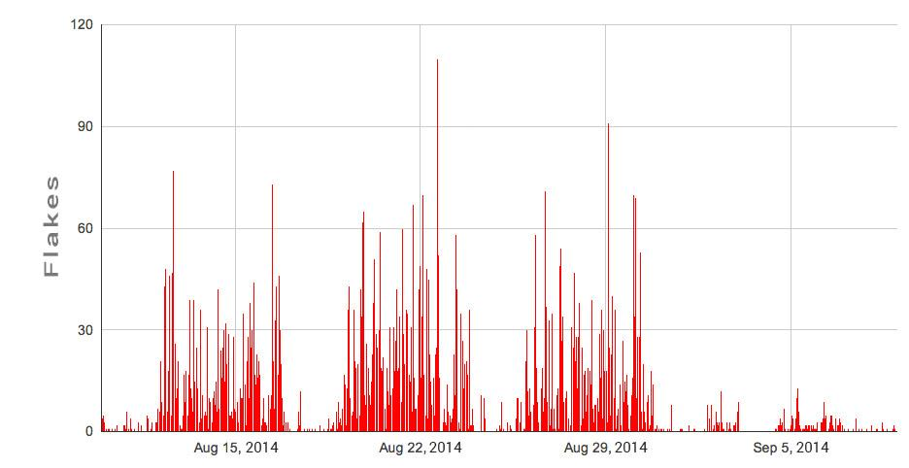
Flaky tests are worse than no tests
Move Fast & Don’t Break Things
Notes:
When we kicked off a major flakiness effort
wrt flakiness we wanted to pass on the onus of flakiness to the person who introduced it and not to everyone else on the team. we started making more tests hermetic; breaking enormous tests into large and medium ones. making sure our tests were not dependent on each other and the order in which they were run.
We bundled bunch of fixes into an experiment and we were able to measure the impact.

Slide 30
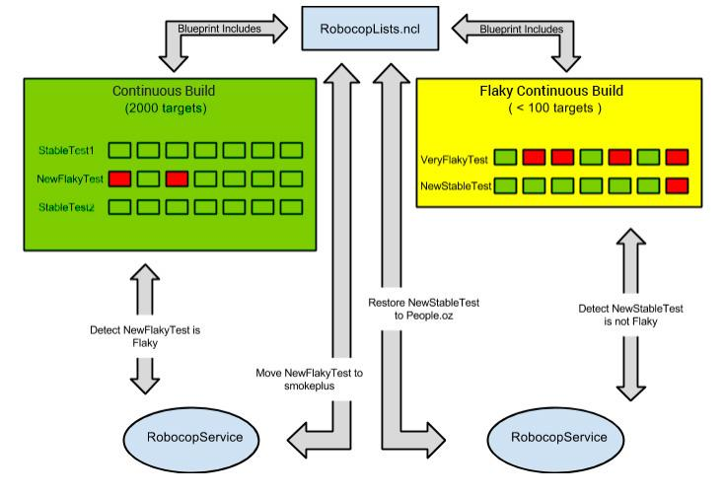
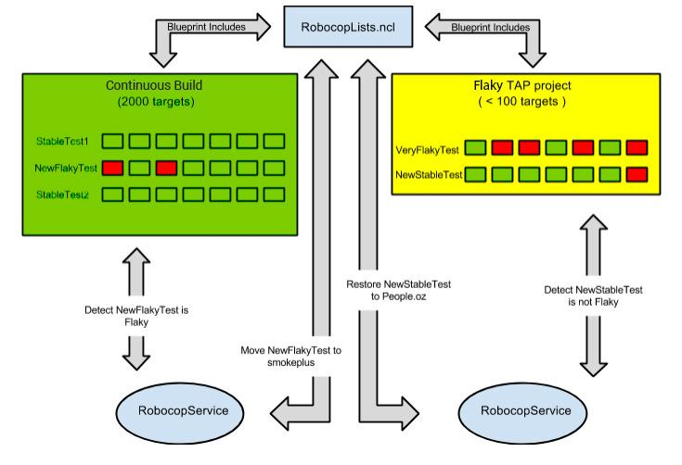
Robosheriff
Move Fast & Don’t Break Things
Notes:
Automatically removes flaky and slow tests out of critical path (presubmit postsubmit and releases)
We are close to adding culprit finding; which will help us identify which cls made the test slow or flaky
This automatically logs the bug and automatically moves the tests back once they are faster and/or stable.

Slide 31
Social @ Google | 2012 | 2013 | 2014 | Assessment
Average presubmit time | 21 min | 28 min | 22 min | Productivity
Code Coverage | ??? | 72.80% | 75.60% | Automation
% Green Cycles | 71.40% | 82.40% | 89.60% | Test Hygiene
Avg Submit to Prod Time | 17 hrs | 11 hrs | 13 hrs | Velocity
Total presubmit run time | 196 d | 11392 d | 8033 d | Better Tests
Total automation time | 22697 d | 52785 d | 114040 d | Better Tests
P1 bugs avg resolution time | 69 d | 28 d | 13 d | Bug Hygiene
Notes:
Average presubmit time is rapidly on its way down thanks to 5 min UI tests
Code coverage has been on the way up
Big focus on effective tests has helped get green cycles up
while submit to prod time seems to have gone up; it’s much less; on Mobile; we don’t have as many builds going to prod.
Total presubmit and automation; is increasing as we continue to add more tests. Reason I have it as a red is I expect us to make tests faster
We have had a heavy emphasis on bug hygiene to ensure we handle incoming user feedback to ensure any big issues are not missed.

Slide 32
Move Fast & Don’t Break Things
Push on Amber
Prevent Bugs
Move Fast & Don’t Break Things
Push Testing upstream
Delineate product releases and features
Fishfood
Productivity First
Notes:
Fishfood: Isn’t very tasty and is barely edible. But helps build up immune system.

Slide 33
Move Fast & Don’t Break Things
Fishfood
Live on the bleeding edge
Bugs get found/fixed
No SLA for fishfood from test
Rapid iterations. 4 hours from design to bug bash for a feature.
Notes:
dogfood is common in the industry. we decided to take it a step further via fishfood
Fishfood is internal, confidential alpha testing.
Expose the goodness and the pain. Some things get fixed out of necessity.
Bugs like can’t send emails or can’t make posts or notifications too noisy will get fixed as they get in the team’s way itself
I don’t sign up to test fishfood as lots of moving pieces. In general. try to keep manual testing as hermetic in a way as possible.
fishfood talks to too many dev servers which are been pushed/updated all the time.
lot of features are not fully implemented and hence lot of noise in bugs logged.

Slide 34
Move Fast & Don’t Break Things
Push on Amber
Prevent Bugs
Move Fast & Don’t Break Things
Push Testing upstream
Prioritize Releases
Delineate product releases and features
Fishfood
Productivity First
Notes:
Prioritize Releases: Grass is greener where you water more

Slide 35
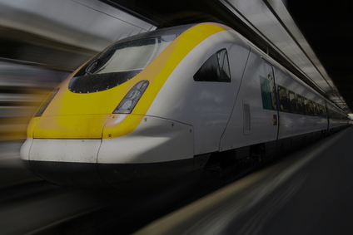
Move Fast & Don’t Break Things
Prioritize Releases
Must be an ongoing commitment
All must want to fix root problems (post-mortem!)
Have a dedicated release team
Make sure everyone understands it
Notes:
Make postmortems a part of the culture. encourage them. learn from then.
Have Best portmortem of the month awards.
Have an onduty rotations. That helps everyone understand how the part they work on; that piece of the puzzle fits into the overall puzzle. the big picture. They have a better understanding of the stack/product from the inside out and that in turn helps them build better features and a better product.
all tech disciplines need to understand how it works

Slide 36
Move Fast & Don’t Break Things
Push on Amber
Prevent Bugs
Move Fast & Don’t Break Things
Treat Regressions as build blockers
Push Testing upstream
Prioritize Releases
Delineate product releases and features
Fishfood
Productivity First
Notes:
Treat Regressions as build blockers: knitting. i did this decades back in school.
i remember undoing more; than making progress.

Slide 37
Treat regressions as build breaks
Move Fast & Don’t Break Things
Cultural shift
Rollback == guaranteed fix
Verifications are simpler
Devs not under gun for fix
Notes:
This one requires a huge cultural and mindset shift.
I stopped doing rollbacks at Google when I crossed 1000 rollbacks.
Now continuous build system auto rolls back cls that don’t compile and break 1000+ targets
Most of the times; we rollback 5 cls instead of taking a speculative 10 line fix.

Slide 38
Move Fast & Don’t Break Things
Push on Amber
Remember Murphy’s Law
Prevent Bugs
Move Fast & Don’t Break Things
Treat Regressions as build blockers
Push Testing upstream
Prioritize Releases
Delineate product releases and features
Fishfood
Productivity First
Notes:
remember Muphy’s Law: Anything that can go wrong will go wrong
We carry extra pair of clothes for kids. extra copy of boarding pass. Most of us still carry some cash around and 2 credit cards when maybe all we need is our phones or watches!

Slide 39
Move Fast & Don’t Break Things
Remember Murphy’s Law
Kill switches for features
Big refactorings behind flags
All user visible changes behind experiments
Notes:
Again: Anything that can go wrong will go wrong.
Be a pessimist. Hope for the best; but expect the worst
Put on your tester aka how do I break things hat here.
Some of the things we have done here: Missing backend testing. to help eek out hard dependencies and so that your product grcefully degrades.
An outage google services had earlier in the year:
most Google users who use logged-in services like Gmail, Google+, Calendar and Documents found they were unable to access those services for approximately 25 minutes
an internal system that generates configurations—essentially, information that tells other systems how to behave—encountered a software bug and generated an incorrect configuration. The incorrect configuration was sent to live services over the next 15 minutes, caused users’ requests for their data to be ignored, and those services, in turn, generated errors

Slide 40
Move Fast & Don’t Break Things
Balance Velocity vs Quality
Push on Amber
Remember Murphy’s Law
Prevent Bugs
Move Fast & Don’t Break Things
Treat Regressions as build blockers
Push Testing upstream
Prioritize Releases
Delineate product releases and features
Fishfood
Productivity First
Notes:
Balance velocity and quality: Making Sangria. you can keep trying to make the perfect one; at some point you just want to drink the damn sangria.

Slide 41
Move Fast & Don’t Break Things
Balance Velocity vs Quality
Gate keepers
Provide risk assessment
Trusted Testers
Things that can’t be risked with: ACLs, data, security, upgrades, migrations
Notes:
Don’t try to block releases/features.
Provide risk analysis and block on bugs in non-negotiable areas like ACLs, data, security, upgrades etc
Get power users involved in helping find corner cases. This also helps get great feedback from end users on what they like/dislike about the product; which in turn helps pivot the product in the right direction.

Slide 42
Move Fast & Don’t Break Things
Balance Velocity vs Quality
Push on Amber
Remember Murphy’s Law
Prevent Bugs
Move Fast & Don’t Break Things
Treat Regressions as build blockers
Push Testing upstream
Prioritize Releases
Delineate product releases and features
Fishfood
Productivity First
Notes:
This was our journey
If you have worked with me over the last 5 years @ Google; this will be boring to you as you have probably heard me say a lot of these things and see me drive a lot of these practices in my daily work and how my teams approach testing.

Slide 43
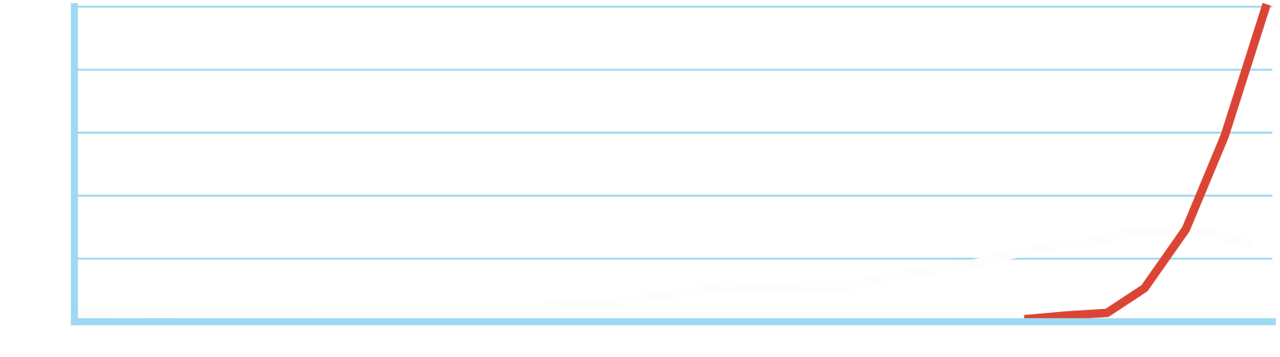
Move Fast & Don’t Break Things
It’s no secret mobile is taking over.
SMARTPHONES & TABLETS
PCS
Notes:
This graph shouldn’t surprise anyone. Majority of our usage comes from mobile.
Over the last couple of years we have started to adapted our test strategies for mobile, including retooling our test infrastructure for mobile.

Slide 44
“Mobile First” Challenges
Move Fast & Don’t Break Things
Balance release velocity - can’t push daily to users.
Mobile app updates use battery and cellular data.
Cannot roll back a bad mobile app easily; higher quality bar needed.
Come join the discussion @ “Move Fast & Don’t Break Things” G+ Community
Notes:
Mobile Development imposes a lot of constraints and we have to adapt our test strategy accordingly. For example:
We cannot update apps on our user’s devices daily. Each app update costs money and consumes battery.
Making our mobile app tests run faster is a big challenge due to the low resource environment.
App performance on mobile matters a lot. Do not want to drain user’s phone batteries or cause high cellular data usage.
Integration testing needs to be rethought for mobile.

Slide 45
Move Fast & Don’t Break Things
Cultural
Cultural + Tooling
Tooling
Balance Velocity vs Quality
Push on Amber
Remember Murphy’s Law
Prevent Bugs
Move Fast & Don’t Break Things
Treat Regressions as build blockers
Push Testing Upstream
Prioritize Releases
Delineate product releases and features
Fishfood
Productivity First
Notes:
Lastly; the steps I outlined are a combination of cultural, tooling and a combination of both.

